Slide 1
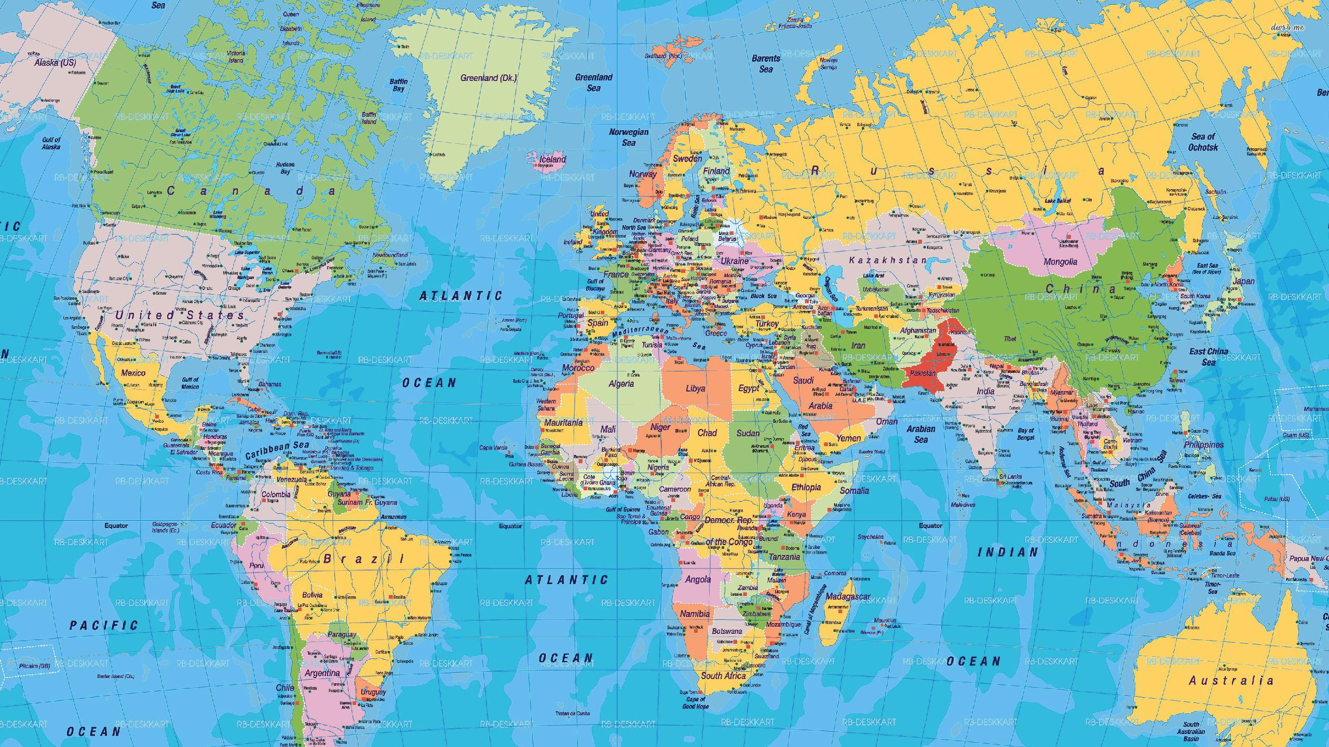
Origin Regions Map
Coffee production spans the 'Bean Belt' (25°N–25°S), with smallholders producing the majority of arabica.
Country: Brazil - Approx share: 37% - Bean mix: Arabica-dominant
Country: Vietnam - Approx share: 17% - Bean mix: Robusta-dominant
Country: Colombia - Approx share: 8% - Bean mix: Arabica
Country: Indonesia - Approx share: 7% - Bean mix: Robusta/Arabica
Country: Ethiopia - Approx share: 4% - Bean mix: Arabica
Country: Others (50+ origins) - Approx share: 27% - Bean mix: Mixed
Notes: Shares are indicative averages; actuals vary by harvest year.

